Slide 1

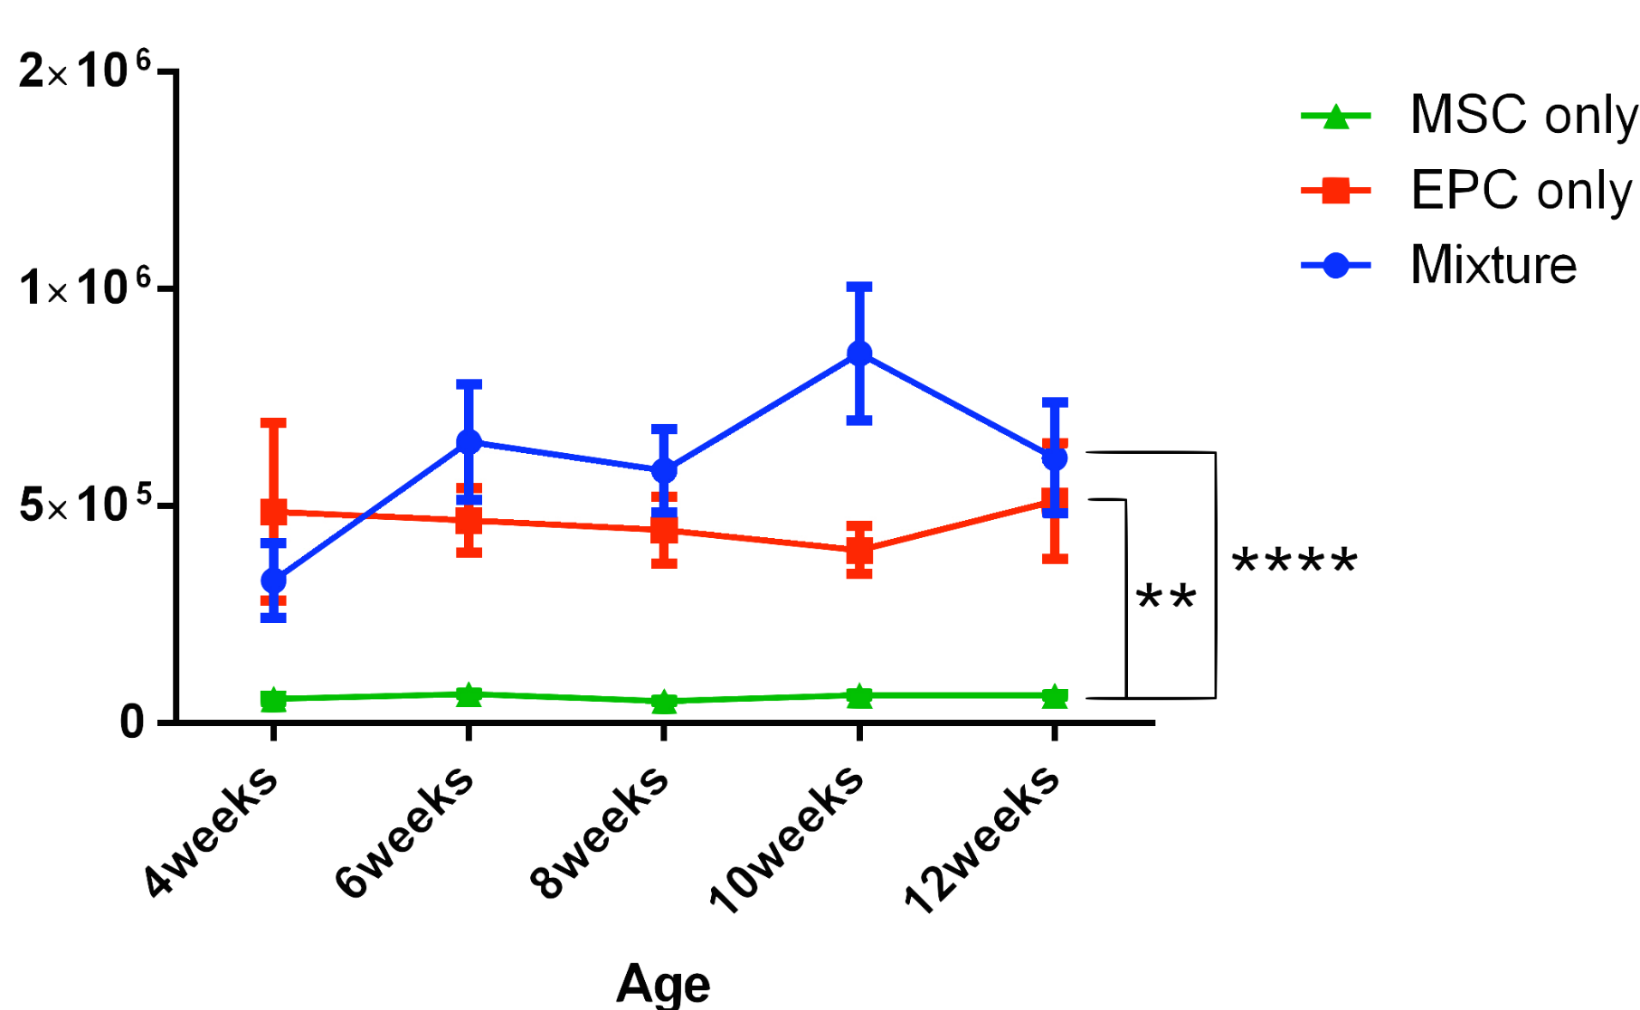
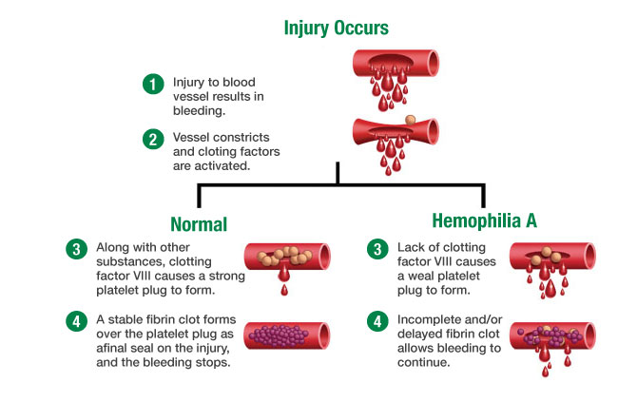
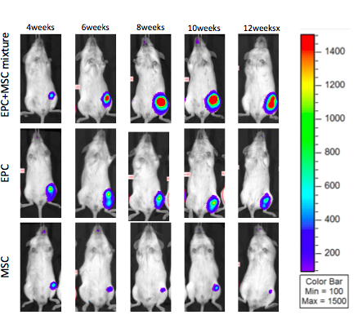
Postnatal Transplantation of
Cord Blood derived Endothelial Progenitor Stem Cells
for the Treatment of Hemophilia A
Muhtada Kamal Aldin MS2, Kewa Gao Phd, Priyadarsini Kumar Phd, Diana Farmer MD, Aijun Wang Phd
Background
Methods
Hemophilia A is an X- linked recessive coagulation disorder caused by lack of coagulation factor VIII with an incidence of 1/5000 in men in all ethnicities, according to the National Hemophilia Foundation. Currently, Infusion of Factor VIII has been the mainstay therapy for Hemophilia A .
Fig2. Quantitative analysis of IVIS
EPC only group and mixture group have significant higher engraftment than MSC only group. Data were expressed as mean ± standard error. **p<0.01, ****p < 0.0001, n=5.
Hu ERV3
Ms GAPDH
Study was conducted using NSG Mice with three preparation groups:
1)EPC only: 3×10⁵ cells
2)MSC only:3×10⁵ cells
3)Mixture: 3×10⁵ EPC + 2×10⁵ MSC cells
Observation: Over the period of 12 weeks, Bioluminescence imaging was taken at 2 week interval at a predetermined time.
Tissue harvest: heart, lung, liver, kidney, spleen, pancreas, muscle and brain.
DNA extraction: Phenol-Chloroform method used. Mouse GAPDH and Human ERV3 primers were used for PCR.
Heart
Lung
Liver
Kidney
Spleen
Muscle
Brain
Pancreas
Fig3. Identify human cells in mouse tissue by PCR
The situation of cell retention in injection site and migration out of the injection site detected in EPC transplantation group by PCR. It shows human cells existing in muscle tissue and lack of migration to internal organs.
Meanwhile, researchers are exploring more methods for producing factor VIII in Hemophilia A patients using transplantation of Endothelial progenitor cells (EPCs), which have high proliferative potential. Another candidate is mesenchymal stem cells (MSCs), which have a high capacity for proliferation, multilineage differentiation and immunomodulatory properties.
Conclusion and Discussion
EPCs and mixture of EPCs and MSCs show a higher engraftment efficiency in muscle tissue than MSCs only as measured by IVIS.
EPC or EPC/MSC co-transplantation can potentially be used to design a long term cure for hemophilia A.
As one of the main problems in hemophilia treatment is the onset of alloantibodies inactivating the infused coagulation factor, exploring pre-natal transplantation is a potential solution.
Results
Study Aims
Fig1. Representative bioluminescence image
Mixture group shows an increase of
signal. EPC only group shows stable signal while MSC group shows a decline of signal over 12 weeks.
We set out to compare the engraftment efficiency of three transplantation strategies: EPC only, MSC only and mixture (EPC+MSC).
References
Hypothesis
Massimo Franchini et al, Past, present and future of hemophilia: a narrative review, Orphanet Journal of Rare Diseases
Everett LA, Cleuren AC, Khoriaty RN, Ginsburg D. Murine coagulation factor VIII is synthesized in endothelial cells. Blood. 2014;123:3697-705.
P Kumar, K Gao, C Wang, C Pivetti, L Lankford, D Farmer, A Wang. In Utero Transplantation of Placenta-Derived Mesenchymal Stromal Cells for Potential Fetal Treatment of Hemophilia A. Cell Transplantation. 2018, in press.
We Hypothesize that the interaction between EPCs and MSCs will help them achieve higher transplant efficiency as opposed to EPCs or MSCs alone.
1. Figure adopted from http://www.newhealthguide.org/.

